Slide 1

L.Y. Project Presentation
“Geospatial Query System with Natural Language Processing and Geographic Information System Integration ”
Guide Name : Dr. Vaishali Wadhe
Group No : 1
Riddhesh Chaudhary (L.Y. A-14)
Arpit Balmiki (L.Y. A-06)
Chirayu Vyas (L.Y. B-63)
Department of AI-DS, K J Somaiya Institute of Technology, Sion, Mumbai
26/6/2023

Slide 2
Sr. No. | Content
1. | Introduction
2. | Literature Survey
3. | Time Plan
4. | Problem Statement
5. | Objectives of Project
6. | Proposed System Implementation
7. | Technology used
8. | Results
9. | Applications
10. | Future Scope
11. | Conclusion
12. | References
Department of AI-DS, K J Somaiya Institute of Technology, Sion, Mumbai
26/6/2023

Slide 3
Introduction
We propose a natural-language spatial intelligence platform for real estate & business site selection.
Ask a question in plain English ("safest area near a metro for a cafe?") and it gives get a grounded map answer, not raw SQL.
Built on real, live Mumbai data: roads, POIs, real estate listings, crime, transit; not synthetic/mocked.
Turns weeks of manual location survey + budgeting into a single instant query.
Generalizable design, built to extend beyond Mumbai to any city with your data.
Department of AI-DS, K J Somaiya Institute of Technology, Sion, Mumbai
26/6/2023

Slide 4
Literature Survey
Sr. No. | Ref. | Methodologies | Objectives | Advantages | Limitations/Research Gaps
1 | T&F: 10.1080/17538947.2023.2278895 | Prototype system LLM-Geo using the GPT-4 API to combine natural language understanding, reasoning, and automated code generation. | To develop an Autonomous GIS that addresses spatial problems across five goals: self-generating, self-organizing, self-verifying, self-executing, and self-growing. | Generates accurate maps, graphs, and aggregated numbers automatically without human intervention. | Still in its infancy; currently lacks critical operational modules such as logging and code testing.
2 | arXiv: 2510.21045 | Multi-agent framework utilizing staged interpretation, schema grounding, logical planning, SQL generation, and execution-based review. | To overcome spatial Text-to-SQL complexity (geographic intent, coordinate systems, and spatial function choice) over PostGIS databases. | Achieved 87.7% accuracy on the SpatialQueryQA benchmark, demonstrating that review agents significantly boost query robustness. | Geodesic-vs-planar distance errors and incorrect aggregation logic on complex multi-step queries.
Department of AI-DS, K J Somaiya Institute of Technology, Sion, Mumbai
26/6/2023

Slide 5
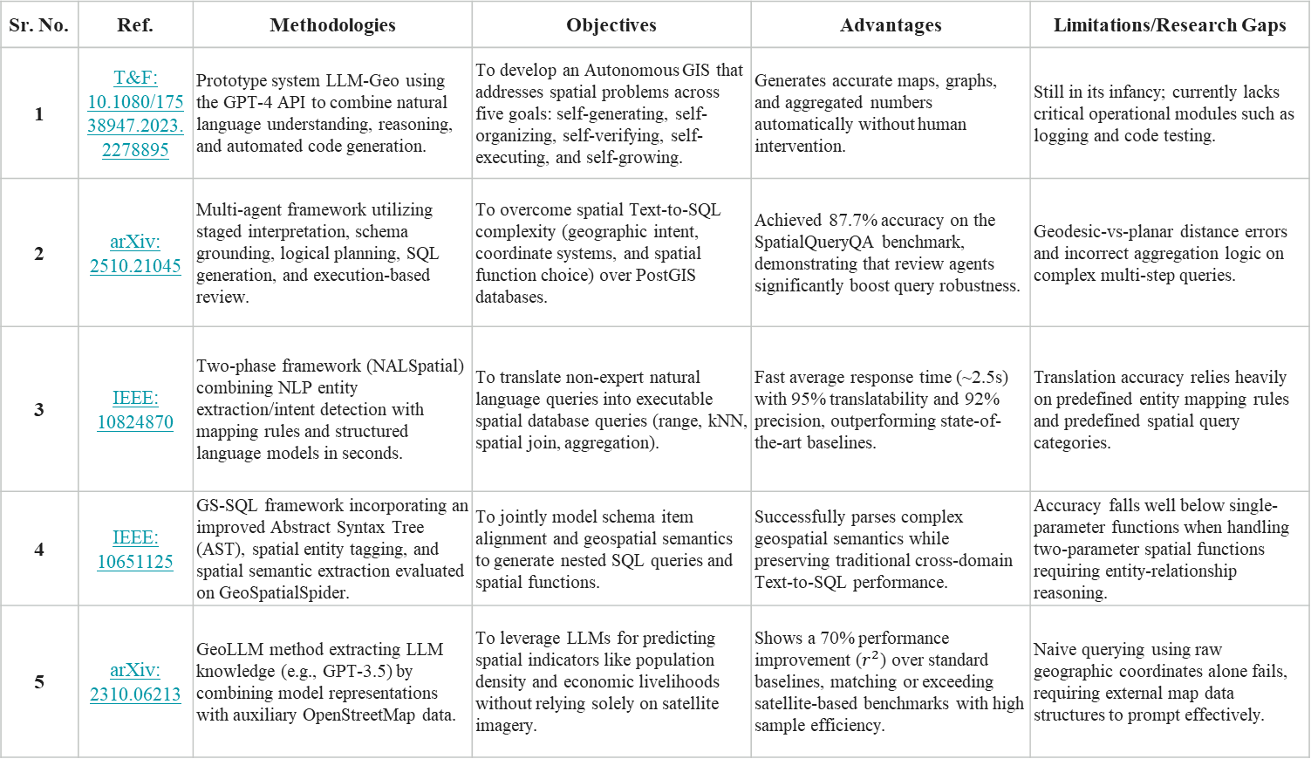
Sr. No. | Ref. | Methodologies | Objectives | Advantages | Limitations/Research Gaps
1 | T&F: 10.1080/17538947.2023.2278895 | Prototype system LLM-Geo using the GPT-4 API to combine natural language understanding, reasoning, and automated code generation. | To develop an Autonomous GIS that addresses spatial problems across five goals: self-generating, self-organizing, self-verifying, self-executing, and self-growing. | Generates accurate maps, graphs, and aggregated numbers automatically without human intervention. | Still in its infancy; currently lacks critical operational modules such as logging and code testing.
2 | arXiv: 2510.21045 | Multi-agent framework utilizing staged interpretation, schema grounding, logical planning, SQL generation, and execution-based review. | To overcome spatial Text-to-SQL complexity (geographic intent, coordinate systems, and spatial function choice) over PostGIS databases. | Achieved 87.7% accuracy on the SpatialQueryQA benchmark, demonstrating that review agents significantly boost query robustness. | Geodesic-vs-planar distance errors and incorrect aggregation logic on complex multi-step queries.
3 | IEEE: 10824870 | Two-phase framework (NALSpatial) combining NLP entity extraction/intent detection with mapping rules and structured language models in seconds. | To translate non-expert natural language queries into executable spatial database queries (range, kNN, spatial join, aggregation). | Fast average response time (~2.5s) with 95% translatability and 92% precision, outperforming state-of-the-art baselines. | Translation accuracy relies heavily on predefined entity mapping rules and predefined spatial query categories.
4 | IEEE: 10651125 | GS-SQL framework incorporating an improved Abstract Syntax Tree (AST), spatial entity tagging, and spatial semantic extraction evaluated on GeoSpatialSpider. | To jointly model schema item alignment and geospatial semantics to generate nested SQL queries and spatial functions. | Successfully parses complex geospatial semantics while preserving traditional cross-domain Text-to-SQL performance. | Accuracy falls well below single-parameter functions when handling two-parameter spatial functions requiring entity-relationship reasoning.
5 | arXiv: 2310.06213 | GeoLLM method extracting LLM knowledge (e.g., GPT-3.5) by combining model representations with auxiliary OpenStreetMap data. | To leverage LLMs for predicting spatial indicators like population density and economic livelihoods without relying solely on satellite imagery. | Shows a 70% performance improvement ($r^{2}$) over standard baselines, matching or exceeding satellite-based benchmarks with high sample efficiency. | Naive querying using raw geographic coordinates alone fails, requiring external map data structures to prompt effectively.

Slide 6
How Our Project Addresses the Research Gaps
Lack of logging and code testing (LLM-Geo): every query is logged, and the generated SQL is validated before it runs on PostGIS, with the SQL and reasoning shown alongside the answer.
Geodesic vs. planar distance and aggregation errors (Spatial Text-to-SQL): distances are computed in metres on the correct coordinate system, and results are checked through execution-based review before an answer is returned.
Dependence on predefined mapping rules (NALSpatial): an LLM interprets intent with schema grounding, so open-ended business questions are handled without a fixed rule set or query categories.
Weak multi-entity spatial reasoning (GS-SQL): complex requests such as "a cafe near a metro in a safe area" are broken into planned steps before SQL is generated.
Raw coordinates alone fail (GeoLLM): answers are grounded in live Mumbai data (roads, POIs, real estate listings, crime and transit) rather than in the model's memory.
Department of AI-DS, K J Somaiya Institute of Technology, Sion, Mumbai
26/6/2023

Slide 7
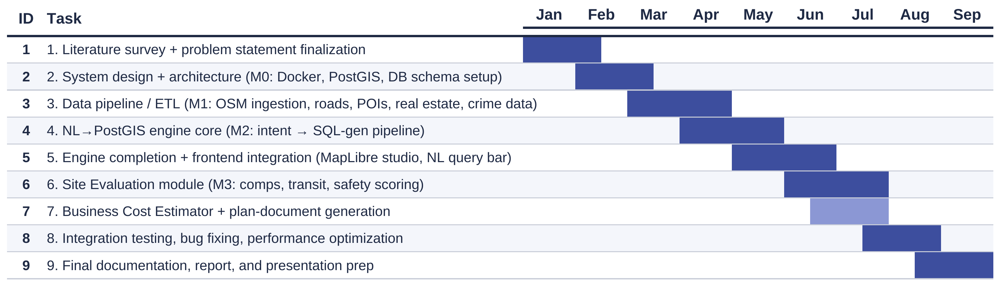
Time Plan
Department of AI-DS, K J Somaiya Institute of Technology, Sion, Mumbai
26/6/2023

Slide 8
Problem Statement
Traditional GIS tools require technical expertise in spatial data, SQL and specialized software a major barrier for non-technical users.
Location suitability is inherently context-dependent: the factors that matter for siting a clinic (accessibility, population) differ from those for a café (footfall, competition) a single fixed scoring formula cannot capture this.
Reliable natural-language-to-spatial-SQL translation is a hard, safety-critical problem: queries must be correctly grounded, generated and verified before execution.
Decisions grounded only in road/amenity data ignore population, time-of-day mobility and environmental context all of which materially affect location suitability.
Department of AI-DS, K J Somaiya Institute of Technology, Sion, Mumbai
26/6/2023

Slide 9
Objectives of Project
The objective of this project is to simplify site selection by helping businesses find and evaluate new locations without manual survey work. The system automatically produces a data-grounded cost estimate, covering rent, setup and licenses, for any chosen spot, and lets users compare locations side by side on nearby comparables, footfall and amenity density, safety and transit access. By replacing scattered manual research across multiple sources with a single natural-language query, it removes the hassle of data gathering and saves both time and cost, delivering instant, grounded answers in place of weeks of on-ground survey.
Department of AI-DS, K J Somaiya Institute of Technology, Sion, Mumbai
26/6/2023

Slide 10
Proposed System Implementation
Department of AI-DS, K J Somaiya Institute of Technology, Sion, Mumbai
26/6/2023

Slide 11
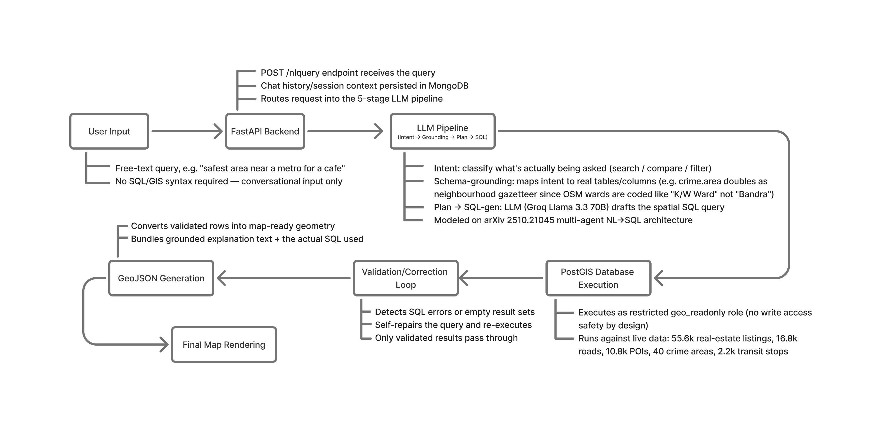
Department of AI-DS, K J Somaiya Institute of Technology, Sion, Mumbai
26/6/2023

Slide 12





Technology Used
Data
Backend
AI
Frontend
Department of AI-DS, K J Somaiya Institute of Technology, Sion, Mumbai
26/6/2023

Slide 13

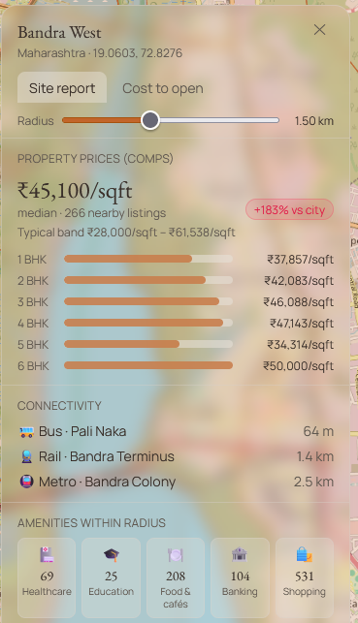
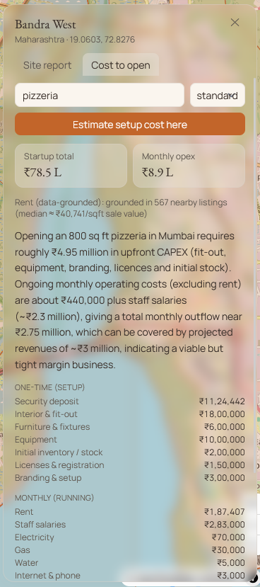
Results
Ask Mumbai city your question in plain English -> get back a map.
IMAGE / VISUAL PLACEHOLDER
Icon: NL Query
IMAGE / VISUAL PLACEHOLDER
Icon: Live Map
IMAGE / VISUAL PLACEHOLDER
Icon: Grounded Answer
“i wanna open pizzeria with 2cr budget”
Price and Area amenities information
Answer + short
explanation, from real data
Department of AI-DS, K J Somaiya Institute of Technology, Sion, Mumbai
26/6/2023

Slide 14
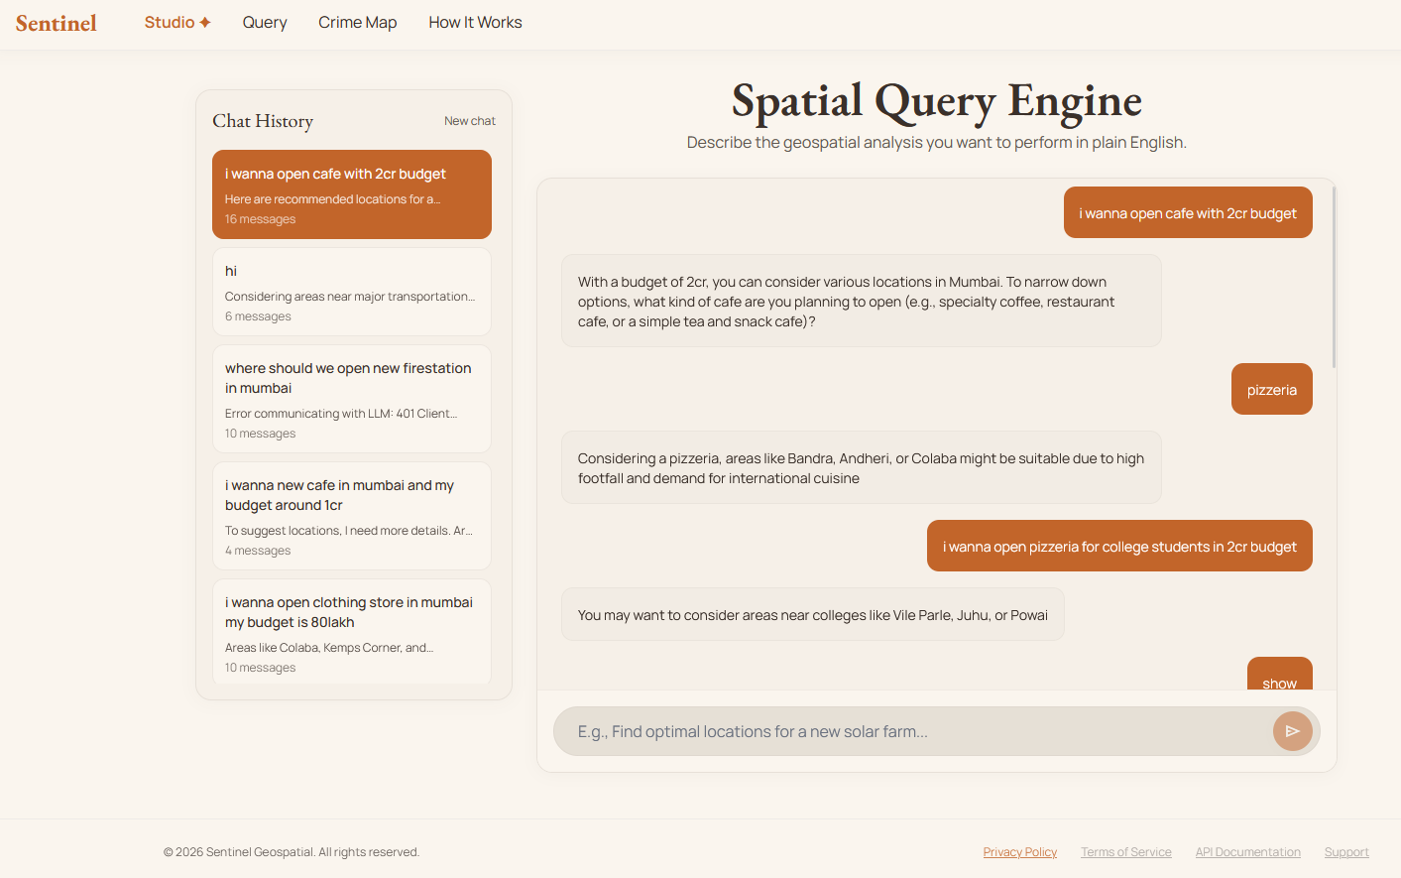

Slide 15
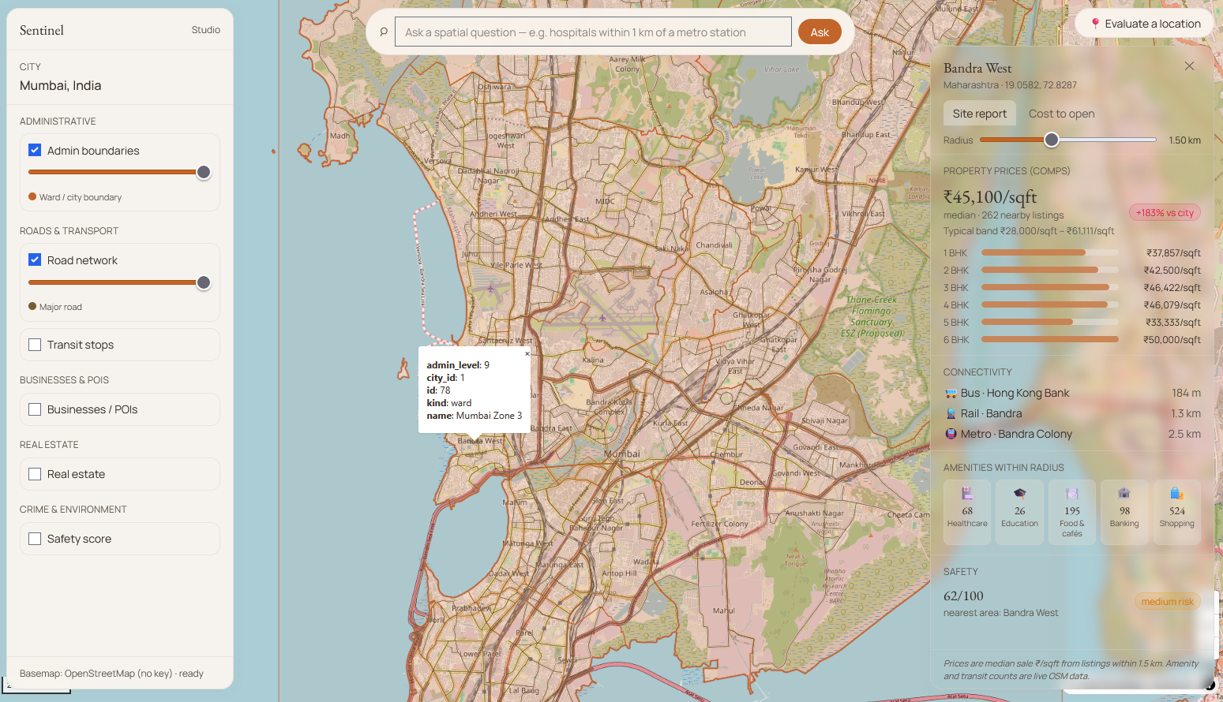

Slide 16
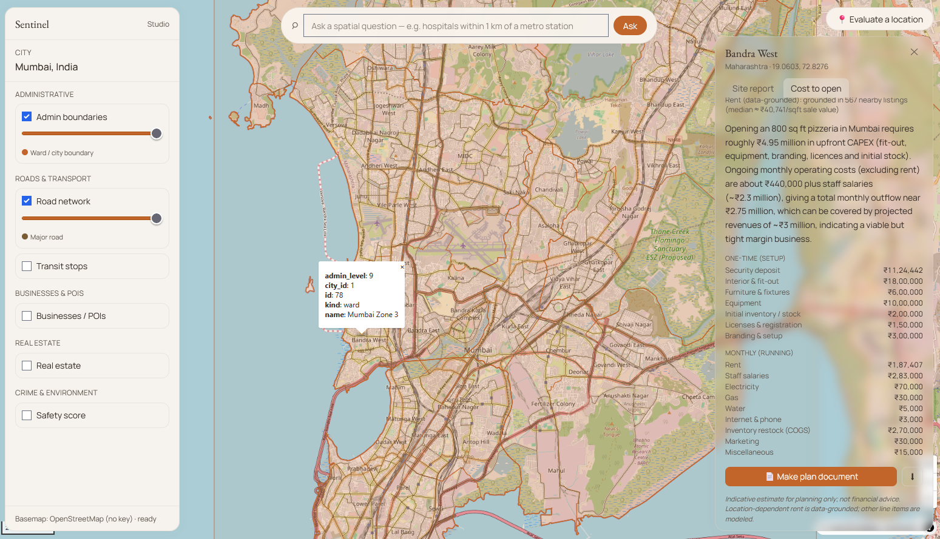

Slide 17
Applications
1
2
3
4
New outlet/store site selection : cafes, restaurants, retail choosing where to open next
Franchise & expansion planning : compare multiple candidate cities/neighborhoods at once
Budget & feasibility check : instant cost estimate before committing to a lease
Investor/pitch-ready reports : auto-generated site + cost comparison to back a business case
Department of AI-DS, K J Somaiya Institute of Technology, Sion, Mumbai
26/6/2023

Slide 18
Future Scope
Real-Time Data Streams
Learned Weight Calibration
Cross-City Generalization
Mobile Application
Department of AI-DS, K J Somaiya Institute of Technology, Sion, Mumbai
26/6/2023

Slide 19
Conclusion
The project demonstrates that natural-language spatial intelligence can meaningfully simplify how businesses choose where to operate. Built on live PostGIS data spanning 48 administrative boundaries, 16,800+ road segments, 10,800+ points of interest, 55,600+ real-estate listings, 2,200+ transit stops, and 40 crime-safety zones across Mumbai, the platform turns a single plain-English query into a grounded, map-based answer complete with the SQL and reasoning behind it. In real evaluations, a data-grounded budget estimate for opening a café in Bandra came out to ≈₹62 lakh, and a premium restaurant in Lower Parel to ≈₹1.3 crore figures generated in seconds rather than the weeks a manual site survey would typically take. By replacing scattered manual research with one unified, verifiable query interface, Our project makes location intelligence accessible to businesses without dedicated GIS or data teams, and its city-agnostic architecture means this same capability can extend well beyond Mumbai.
Department of AI-DS, K J Somaiya Institute of Technology, Sion, Mumbai
26/6/2023

Slide 20
References
[1] A. K. Kazazi, Z. Li, M. N. Lessani, and G. Cervone, “From Questions to Queries: An AI-powered Multi-Agent Framework for Spatial Text-to-SQL,” arXiv, 2025.
[2] X. Zhang, F. Xiao, L. Yan, and Z. Zhang, “GS-SQL: Modeling Spatial Semantics in Spatial Text-to-SQL,” IJCNN, 2024.
[3] G. Andrienko et al., “Geovisual analytics for spatial decision support: Setting the research agenda,” Int. J. Geographical Information Science, vol. 21, pp. 839–857, 2007.
[4] R. Wen and S. Li, “Spatial Decision Support Systems with Automated Machine Learning: A Review,” ISPRS Int. J. Geo-Information, vol. 12, p. 12, 2022.
[5] G. Katsogiannis-Meimarakis and G. Koutrika, “A survey on deep learning approaches for Text-to-SQL,” The VLDB Journal, vol. 32, no. 4, pp. 905–936, 2023.
[6] M. Haklay and P. Weber, “OpenStreetMap: User-Generated Street Maps,” IEEE Pervasive Computing, vol. 7, no. 4, pp. 12–18, 2008.
[7] J. Malczewski, “GIS-based multicriteria decision analysis: a survey of the literature,” Int. J. Geographical Information Science, vol. 20, no. 7, pp. 703–726, 2006.
Department of AI-DS, K J Somaiya Institute of Technology, Sion, Mumbai
26/6/2023

Slide 21
References
[8] Y. Zheng, L. Capra, O. Wolfson, and H. Yang, “Urban Computing: Concepts, Methodologies, and Applications,” ACM TIST, vol. 5, no. 3, pp. 1–55, 2014.
[9] R. O. Obe and L. S. Hsu, PostGIS in Action, 3rd ed. Manning Publications, 2021.
[10] M. Gritta, M. T. Pilehvar, C. Lignos, and N. Collier, “What's missing in geographical parsing?,” Language Resources and Evaluation, vol. 52, no. 2, pp. 603–623, 2018.
[11] X. Cao, G. Cong, C. S. Jensen, and B. C. Ooi, “Collective spatial keyword querying,” in Proc. ACM SIGMOD, 2012, pp. 373–384.
[12] Felt, “Felt AI: AI-powered GIS and mapping platform,” Felt Help Center, 2025. [Online]. Available: https://help.felt.com/felt-ai
Department of AI-DS, K J Somaiya Institute of Technology, Sion, Mumbai
26/6/2023

